Slide 1
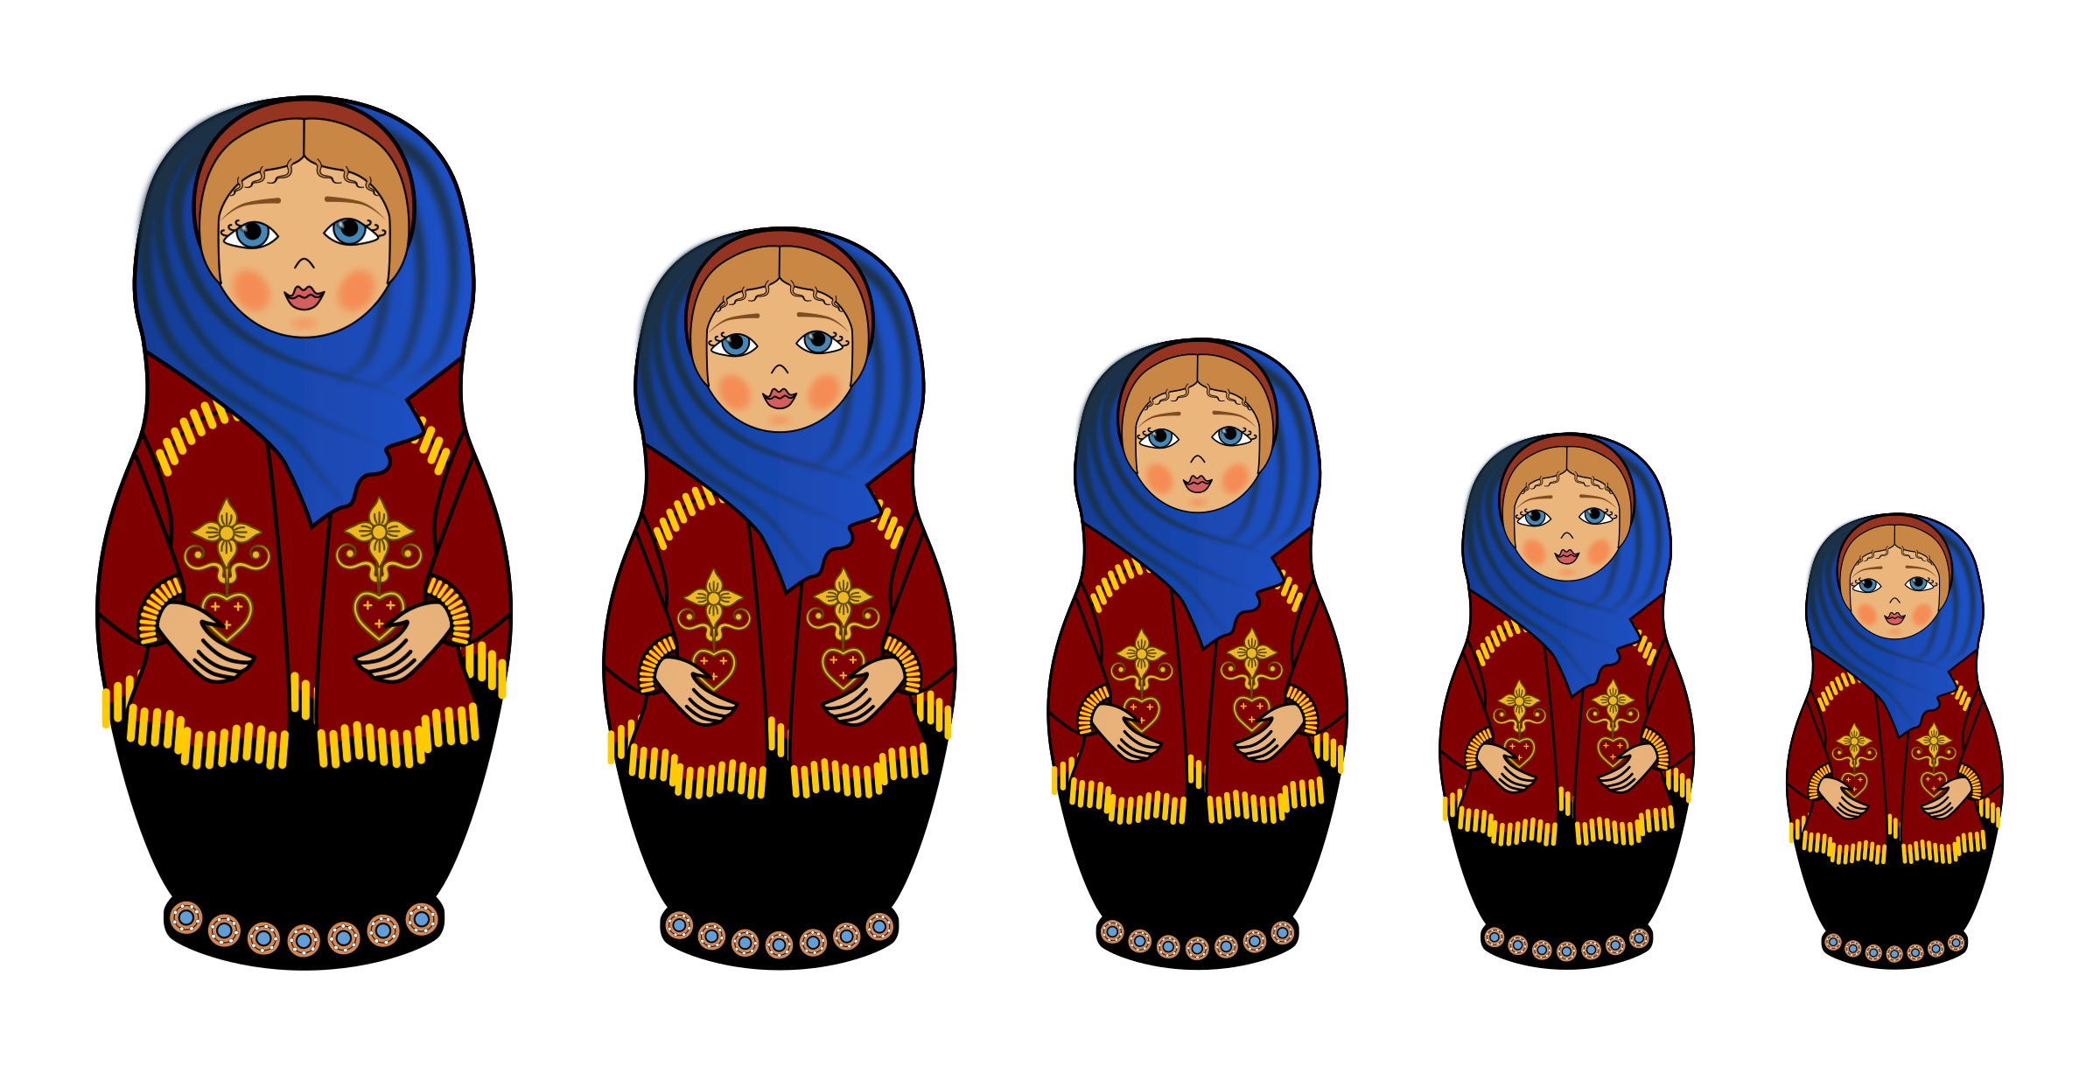
Generics
"If it walks like a duck and it quacks like a duck, then it must be a duck.“
-Some computer scientist

Slide 2
Generic Types
Generic types are compound types that use a generic definition:
LinkedList<T>
HashMap<K,V>
Queue<V>
Most modern languages have generic support.
LinkedList<String>
“Bob”
“Joe”
“Ed”

Slide 3
Using Generic Types
To declare a generic type, add the subtype(s) to the type declaration between <>:
01 02 03 04 05 06 07 08 09 10 11 12 13 14 15 16
import java.util.*;
public class JukeBox
{
public static void main(String[] args)
{
Queue<String> songs = new LinkedList<String>();
songs.add("Barbie Girl");
songs.add("Dancing Queen");
songs.add("I Need A Hero");
while (songs.peek() != null)
System.out.print("[" + songs.remove() + "] ");
}
}
JukeBox.java
Output
[Dancing Queen]
[I Need A Hero]
[Barbie Girl]

Slide 4
Creating Generic Types
To create a generic class type, add the subtypes to the class declaration between <>:
01 02 03 04 05 06 07 08 09 10 11 12 13 14 15
import java.util.*;
public class Pair<F, S>
{
private F first;
private S second;
public Pair(F _first, S _second)
{
first = _first;
second = _second;
}
public F getFirst() { return first; }
public S getSecond() { return second; }
}
Pair.java

Slide 5
Comparator Interface
The Comparator<> interface is built into Java and lets us sort objects:
01 02 03 04 05 06 07 08
public class CharCompare implements Comparator<Character>
{
public int compare(Character c1, Character c2)
{
if c1.getName().equalsIgnoreCase(c2.getName())
return 0;
else if (c1.getName().compareToIgnoreCase(c2.getName()) > 0)
return 1;
else
return -1;
}
}
Character.java

Slide 6
Comparable Interface
The Comparable<> interface allows an object to compare itself to another:
01 02 03 04 05 06 07 08
public class Character implements Comparable<Character>
{
protected String name = "Some Character";
protected int level = 0;
public String getName() { … }
public int getLevel() { … }
public int compareTo(Character other)
{
if name.equals(other.name)
return 0;
else if (name.compareTo(other.name) > 0)
return 1;
else
return -1;
}
}
Character.java

Slide 7
Generic Methods
A generic method is a single method that can act on different types of data:
01 02 03 04 05 06 07
public static <T extends Comparable<T>> T max(T t1, T t2)
{
if (t1.compareTo(t2) < 0)
return t2;
else
return t1;
}

